Slide 1
跟着Kevin学英语(1)
认识字母表

Slide 2
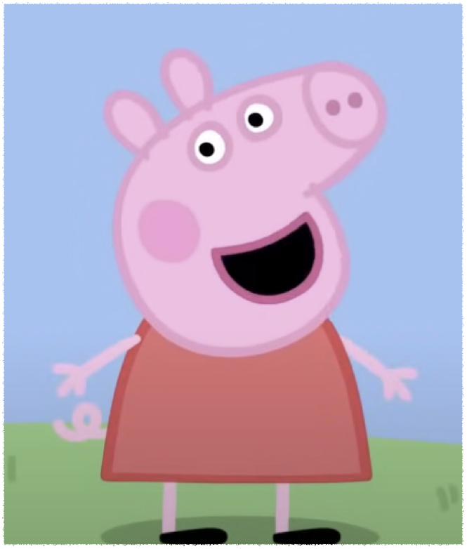
P p
Pig
Puddle
Notes:
This is Peppa pig

Slide 3


P p
Pig
Puddle
Notes:
Peppa loves jumping in muddy puddles

Slide 4
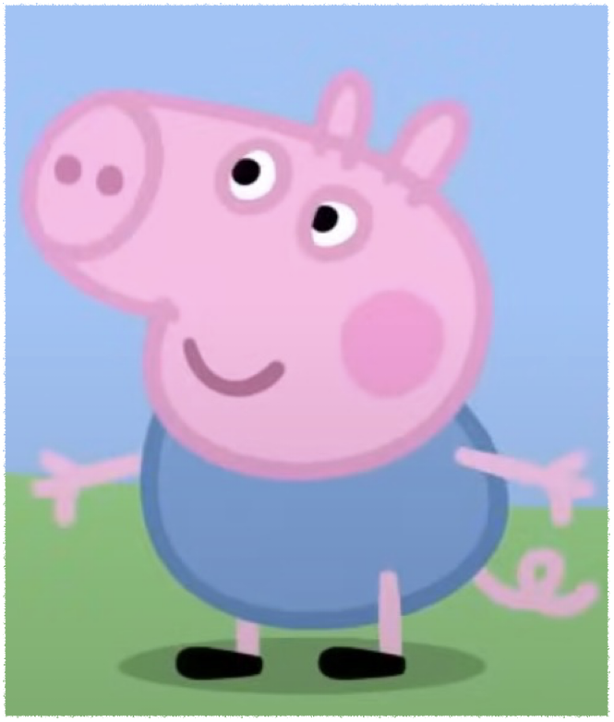
B b
Brother
Boot
Notes:
This is my little brother George

Slide 5
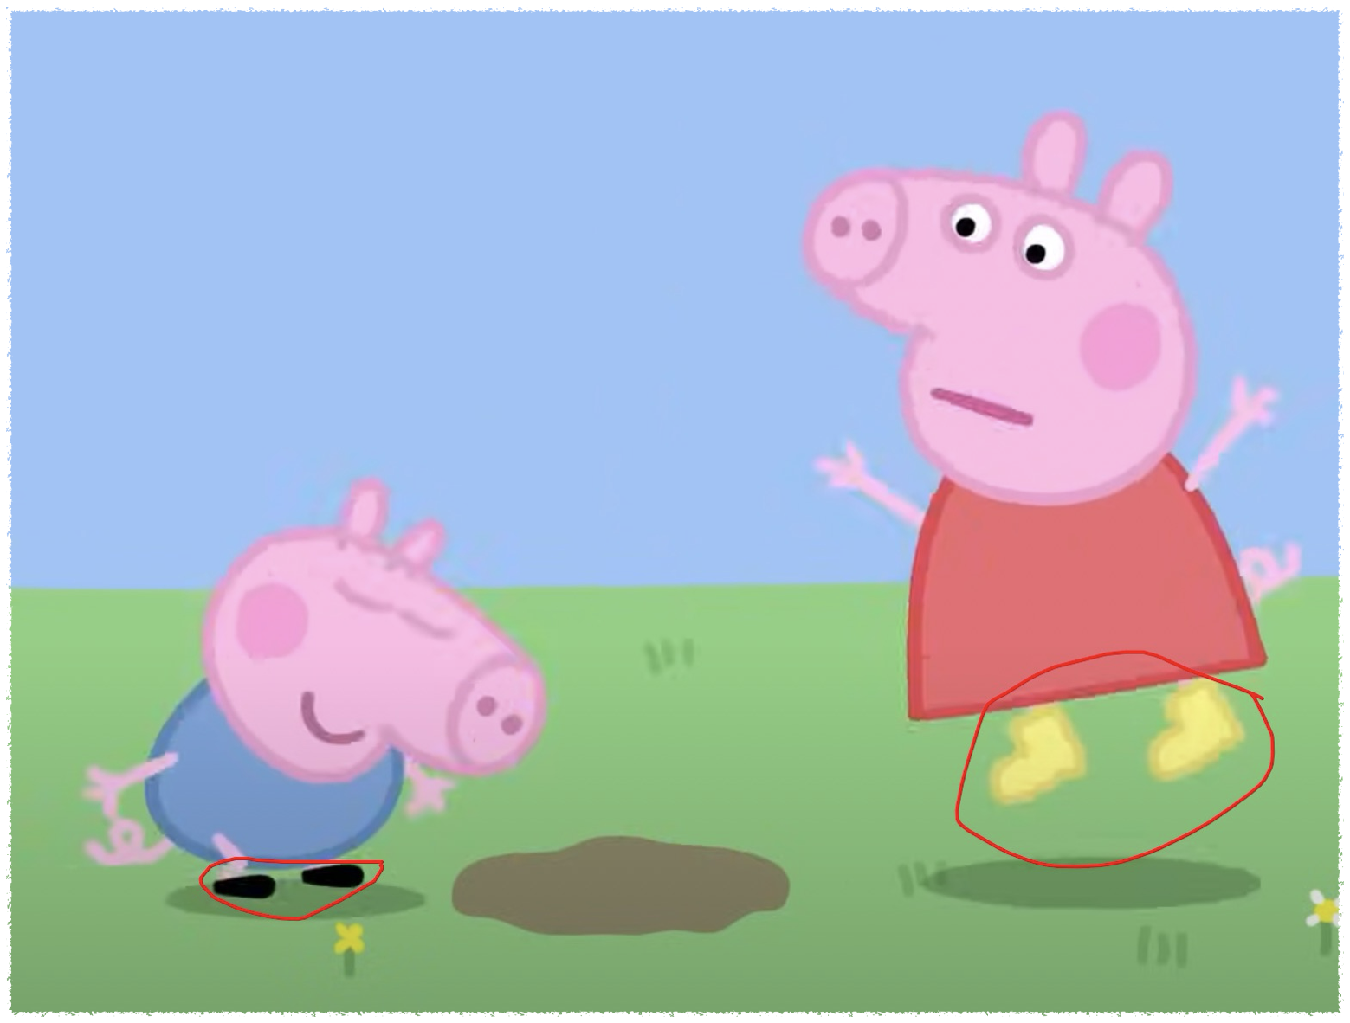
B b
Brother
Boot
Notes:
You must wear your boots

Slide 6
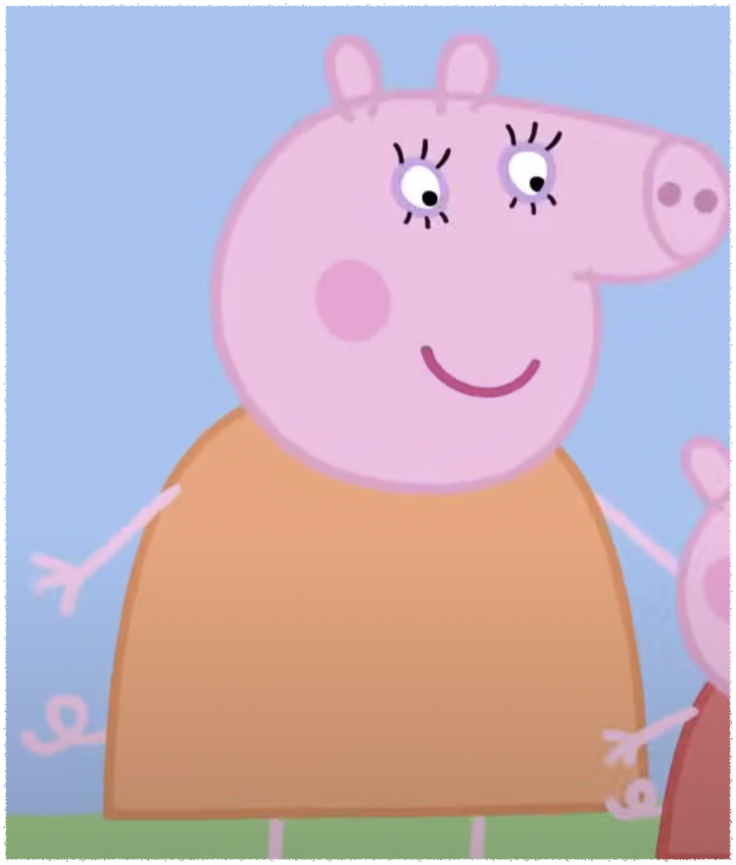
M m
Mommy
Mud
Notes:
This is mummy pig

Slide 7

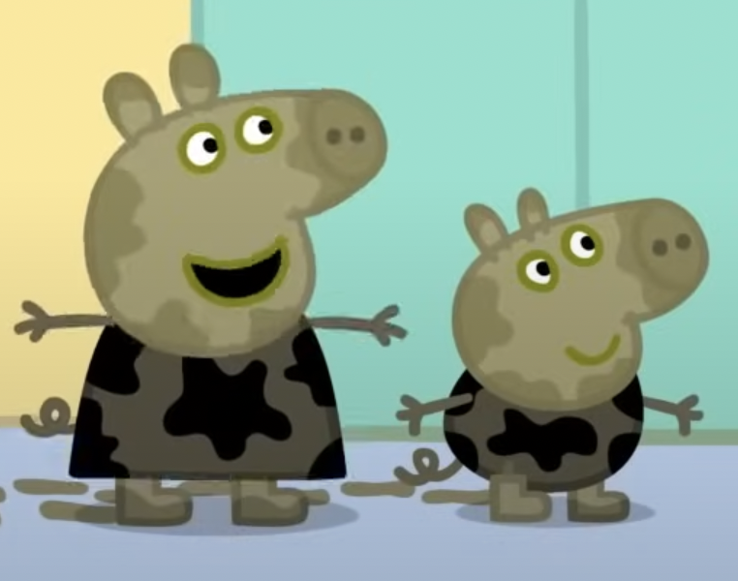
M m
Mommy
Mud
Notes:
It’s only mud

Slide 8
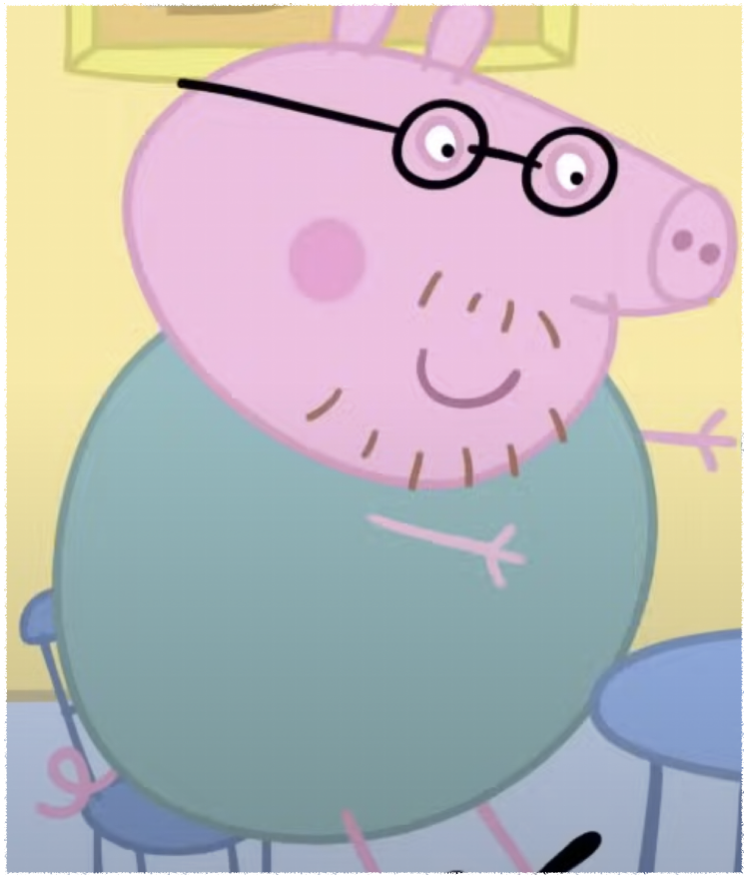
D d
Daddy
Down
Notes:
This is daddy pig

Slide 9
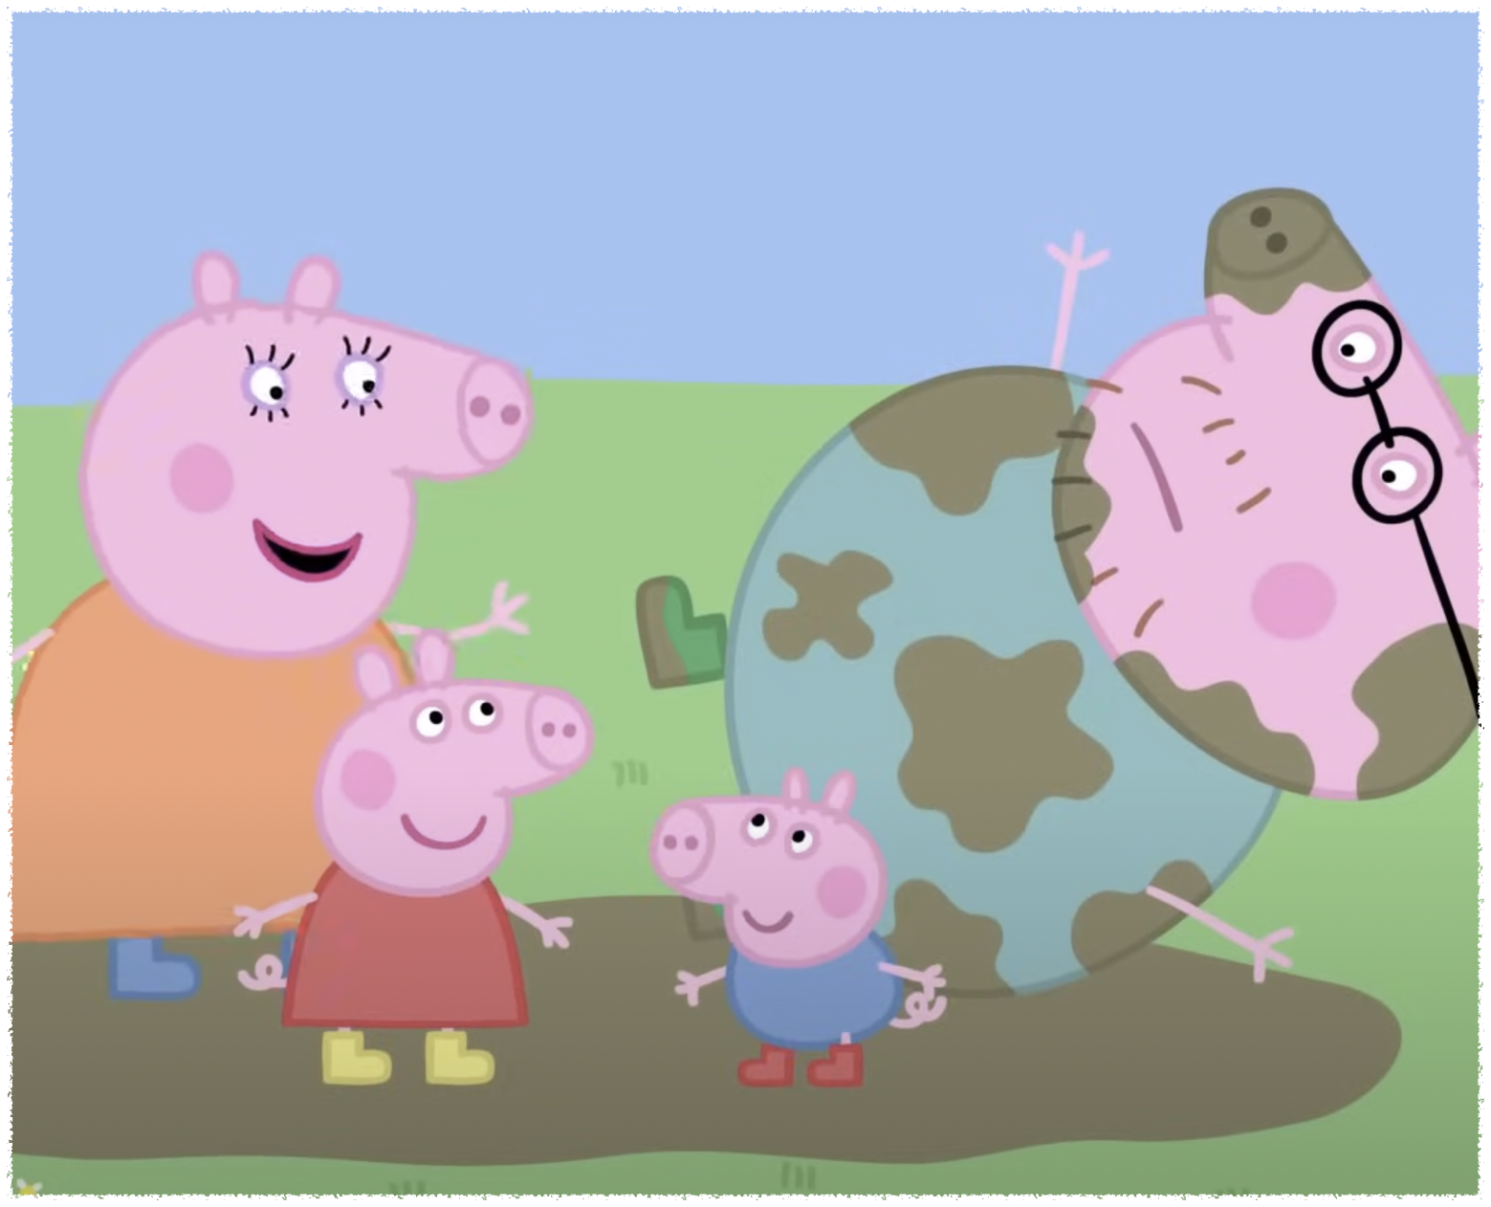
D d
Daddy
Down
Notes:
Everyone loves jumping up and down in muddy puddles

Slide 10


R r
Rain
Notes:
It is raining today

Slide 11
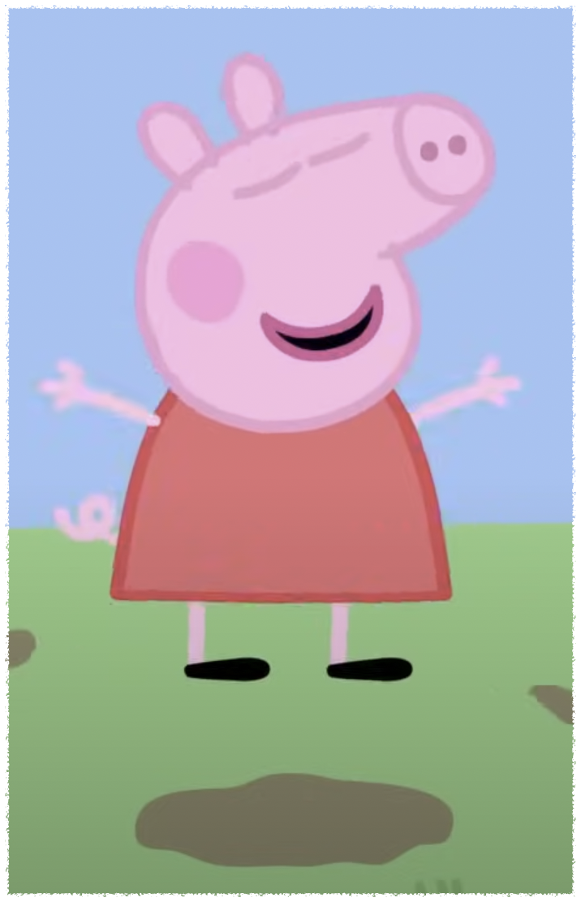
J j
Jump
Notes:
If you jump in muddy puddles

